Slide 1

Using Windows Presentation Foundation in AutoCAD Part 2
Fenton Webb
Senior Developer Specialist

Slide 2

About the Presenter
Fenton Webb Developer Technical Services Americas Autodesk, Inc
Fenton has been a member of the Autodesk DevTech team since 2000. Originally a member of our EMEA team, he has recently relocated to California to work for DevTech Americas. Fenton is an expert in all the AutoCAD APIs, AutoCAD OEM, RealDWG and Revit. He particularly enjoys travelling to evangelise the APIs he support at our annual Developer Days conferences.
Before joining Autodesk, Fenton worked for an ADN partner developing ObjectARX applications in the Civil and Structural Engineering domain.

Slide 3
Webcast Objective
I’m going to…
Give an Overview talk about Windows Presentation Foundation
Show you how you can use it in your own applications inside AutoCAD
Let you see how easy and powerful it is and what it can do for you
I’m not going to…
Teach WPF directly, sorry ☹

Slide 4
Please Note
This presentation is being recorded!!
You will be emailed when the
recording is posted for download

Slide 5
Agenda
Part 2
Let’s Recap Part 1
Databinding, Databinding, Databinding
Described
Harnessing
Demos
Further Reading
Questions

Slide 6
What is WPF?
Technical Information
Windows Presentation Foundation
Next Generation Graphical developer Platform from Microsoft
Driven by Direct3D
Built in 3D Graphics Engine
Uses XAML
eXtensible Application Markup Language
XML based
Declarative Language
Requires very little programming
Similar Control Class hierarchy to WinForms
All Support rich content, regardless of control type
You Can add images or videos to a Listbox for instance
Uses Vector Graphics
Built in Effects
Can create your own shaders
Notes:
The Microsoft .NET Framework version 3.0, formerly WinFx, is the next version of the Microsoft developer platform. The .NET Framework 3.0 consists of the existing .NET Framework version 2.0 components as well as four new developer-focused innovative technologies: Windows Presentation Foundation (WPF), Windows Communication Foundation (WCF), Windows Workflow Foundation (WF), and Windows CardSpace (CardSpace). The .NET Framework 3.0 ships with Windows Vista and is available for Windows XP SP2 and Windows Server 2003.

Slide 7
Why use WPF?
Realisations
User Experience is Key
“It’s not about the product, it’s about the user experience integrated with the product”
This is what WPF is all about!
Existing Software platforms don’t allow for proper mixing of UI Elements
How about combining a Listbox filled with a list of Videos!?
Or tooltip with a bitmap in it?!
Or a button with different format text on it?
This allows you to create a great User Experience!
Always been difficult to get Product Designers to communicate their ideas properly to Engineering!
This is what XAML is all about…. Separate the UI from the data - Developers for developing and Product Designers for pixel-picking!
Notes:
Note to self – see the transcript AVI from here https://www.microsoftelearning.com/courseAccess/coursePlayer.aspx?courseId=85488&topicId=-1

Slide 8
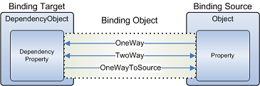
WPF – Databinding, Databinding, Databinding
Described
Synchronizes (Binds) data between 2 properties
Generally used for binding a UIElement to backend data
OneWay, TwoWay, OneWayToSource, OneTime
Can be configured separately using Mode=OneWayToSource, if required
Works for an entire collection too!
Can also be used to bind controls to other controls
Slider to Numeric Editbox, for instance
Notes:
our use the Mode property to specify the direction of the binding. The following enumeration list shows the available options for binding updates:
TwoWay updates the target property or the property whenever either the target property or the source property changes.
OneWay updates the target property only when the source property changes.
OneWayToSource updates the source property when the target property changes.
OneTime updates the target property only when the application starts or when the DataContext undergoes a change.
Default causes the default Mode value of target property to be used.

Slide 9
WPF – Databinding, Databinding, Databinding
Harnessing
OneWay Scenarios
Modal access to data
Working with pure CLR properties, like Boolean, String
TwoWay Scenarios
Modeless access to data
CLR Properties require work
Implement INotifyPropertyChanged interfaces

Slide 10
WPF – Databinding, Databinding, Databinding
Harnessing
Can be implemented in 3 ways
Binding directly to a CLR property
Not really a clean Databinding scenario, but can be done.
Use DependencyProperty inside a DependencyObject derived class
Easy implementation
Not much control
But works really well
Implement INotifyPropertyChanged / INotifyCollectionChanged
Much more work to implement
Total control
Notification Framework
Good for hooking in other tasks
AutoCAD’s Ribbon uses INotifyPropertyChanged exclusively

Slide 11
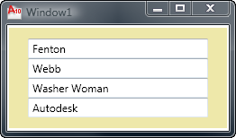
WPF Databinding - Demos
To a CLR property
Demo
Modal Binding to Native CLR
Demonstrating
Binding to CLR class
OneWay - UI Updates Data
OneWay Scenario
Only Modal access to data
Pure CLR properties
CLR properties are raw
No Event mechanism

Slide 12
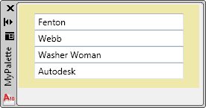
WPF Databinding - Demos
To a CLR property using INotifyPropertyChanged
Demo
Modeless Binding to Native CLR
Demonstrating
Binding to CLR class
Implements INotifyPropertyChanged
TwoWay Scenario
Modeless access to data
Pure CLR properties
CLR properties are still raw
INotifyPropertyChanged
Subscribe to PropertyChanged
Fire notifications in get/set

Slide 13
WPF Databinding - Demos
To a DependencyProperty
Demo
Modeless Binding to
DependencyProperty
Demonstrating
Binding to DependencyObject class
TwoWay Scenario
Replace CLR properties
DependencyProperty
Modeless access to data
Everything is automatic
Have to implement get/set

Slide 14
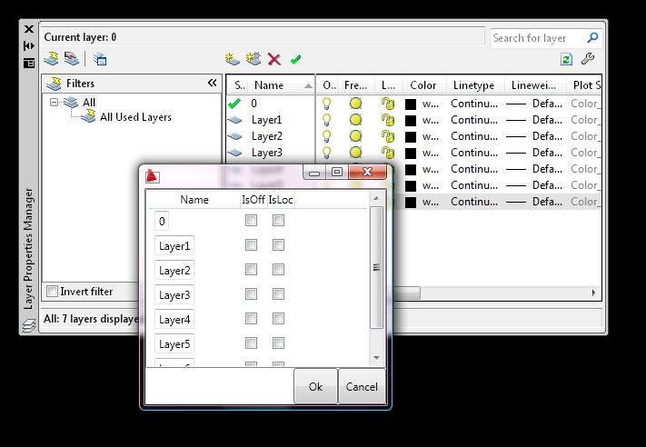
WPF Databinding - Demos
To an AutoCAD CLR Database property
Demo
Modal Binding to AutoCAD
CLR Property
Demonstrating
Binding to AutoCAD Database Property
Must be opened for write
OneWay - UI Updates Data
OneWay Scenario
Only Modal access to data
Still CLR properties
No Event mechanism
AutoCAD Database Property
Must be opened for Write!

Slide 15
WPF Databinding - Demos
To an AutoCAD CLR Extended Database property
TwoWay Scenario
Modeless access to data
Still CLR properties
No Event mechanism
AutoCAD Database Property
Must be opened for Write!
Not easy!

Slide 16
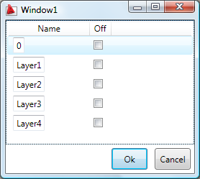
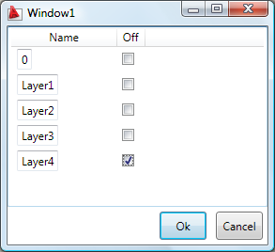
WPF Databinding Data Layer
Modeless AutoCAD TwoWay!
Encapsulates
UI to drawing data transfer
Drawing to UI data transfer
CollectionChanged
PropertyChanged
Data layer
0
Layer1
Layer2
Layer3
Layer4
Idle event
ObjectClosed event
Drawing database
0
Layer1
Layer2
Layer3
Layer4

Slide 17
WPF Databinding - Demos
To an AutoCAD CLR Extended Database property
Demo
Modeless Binding to AutoCAD
CLR Property
Demonstrating
Binding to AutoCAD Database Property
Must be opened for write
OneWay - UI Updates Data
TwoWay Scenario
Modeless access to data
Still CLR properties
No Event mechanism
AutoCAD Database Property
Must be opened for Write!

Slide 18
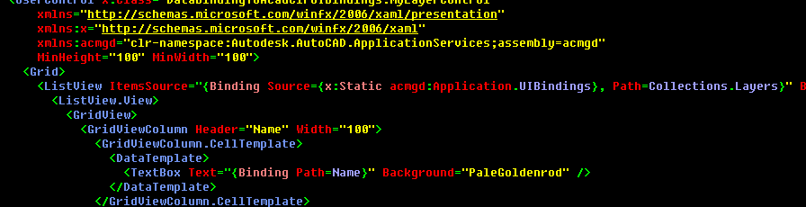
WPF Databinding - Demos
To an AutoCAD CLR Database property using UIBindings
Demo
Binding to AutoCAD CLR Property
using UIBindings
Demonstrating
Binding to AutoCAD Database Property
So much easier!
Any-Way Scenario!!
Modal or Modeless!!
So EASY!
First version

Slide 19
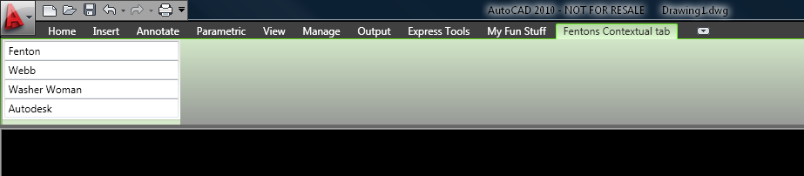
WPF Databinding - Demos
Using a Custom Ribbon Control
Demo
Binding to AutoCAD CLR Property
using INotifyPropertyChanged
Demonstrating
Binding to AutoCAD Database Property
So much easier!
TwoWay Scenario
Modeless
Using INotifyPropertyChanged
Just as an example
You can use UIBindings also
Contextual

Slide 20
WPF
Further reading...
Getting Started - WPF - Get Started
Accessibility - Accessibility Best Practices
Localization - WPF Globalization and Localization Overview
Performance - Optimizing WPF Application Performance
Security - Windows Presentation Foundation Security
Interoperation - WPF and Win32 Interoperation Overview

Slide 21
WPF
More Further reading...
SDK and Samples
www.objectarx.com
Developer Center
www.autodesk.com/developautocad
Discussion Groups
http://discussion.autodesk.com
API Training Classes
www.autodesk.com/apitraining
Kean’s Through the Interface Blog
http://blogs.autodesk.com/through-the-interface
Autodesk Developer Network
www.autodesk.com/joinadn

Slide 22
Using Windows Presentation Foundation in AutoCAD Part 2
Thank you – Any questions?
Fenton Webb
Senior Developer Specialist

